Slide 1
Final Project Presentation Programme: B. Tech in CSE
Mentor : Dr. Nayana B R
Group No. : 17
Team Leader : Varun Raj B
Department : Computer Science

Slide 2
Project Team
Sl no. | Registration no. | Students
1 2 3 4 | 20ETCS002152 20ETCS002055 20ETCS002151 20ETCS002117 | Varun Raj B H N Chetangowda V Sri Venkat Saniya K R

Slide 3
Outline
Title and Aim
Objectives
Methods and Methodology ( or Block Diagram)
Status of the Work
Results
Expected Outcomes
Cost Estimation
Gantt Chart
References

Slide 4
Title
Brand Reputation Analysis based on YouTube Comments
Aim
To develop a system for brand reputation analysis by extracting insights from user comments
on YouTube videos related to a specific brand and provide actionable feedback.

Slide 5
Objectives
To Conduct a literature review to gather insights on sentiment analysis, NLP techniques, and brand reputation analysis specific to YouTube comments.
To Collect and preprocess data, including cleaning and preparation. Acquire labelled data through a pretrained NLP model and conduct additional data processing.
To Train and fine-tune the model using appropriate machine learning or deep learning algorithms.
To Evaluate model using metrics, optimize as needed. Test with real YouTube comments via appropriate UI.

Slide 6
Methods and Methodology
Objective | Method/ Methodology | Description
1. | A literature review is conducted by searching relevant publications to identify key studies and research papers. | We examine scholarly works to identify sentiment methodologies in the fields of NLP, deep learning, and previous YouTube comment projects.
2. | Dataset is gathered via YouTube API and Labelled using VADER. The resulting labeled data is processed using NLTK tools. | This process involves gathering data using YouTube API. Doing Sentiment labelling using VADER (A tool that assigns sentiment scores based on word valence and context).
3. | Exploring diverse deep learning models through experimentation, utilizing Python's deep learning libraries such as TensorFlow and Keras. | Various deep learning models are explored to achieve optimal performance through systematic experimentation
4. | Selecting the optimal model based on performance metrics. Subsequently, real comments are tested with the UI to confirm the chosen model's effectivness. | The best model is chosen by assessing performance metrics, including accuracy, precision, recall, and F1-score. Real comments are then tested with the UI to validate the chosen model's effectiveness.

Slide 7
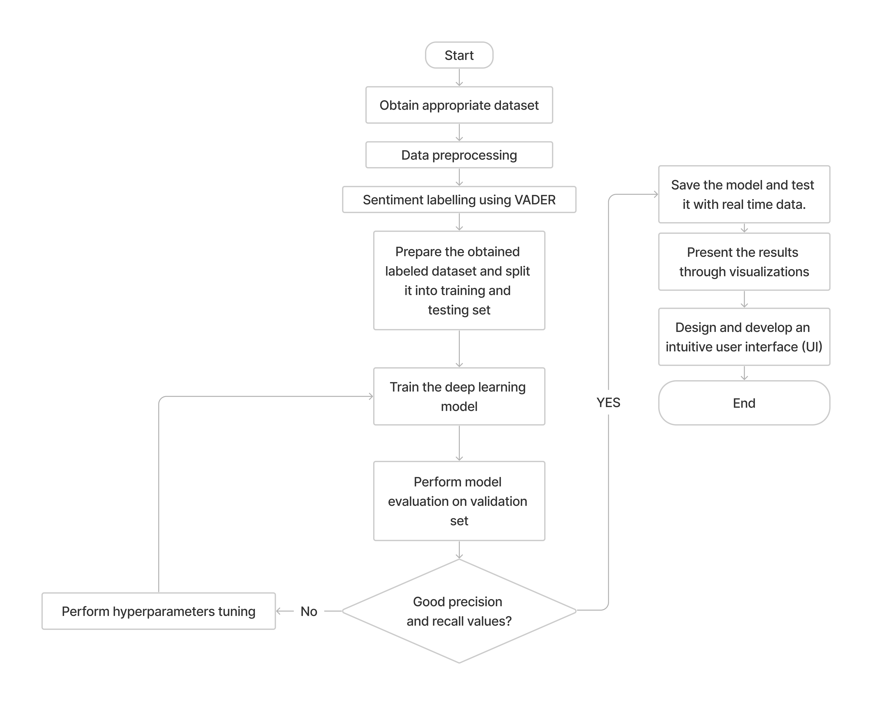
Flow Chart

Slide 8
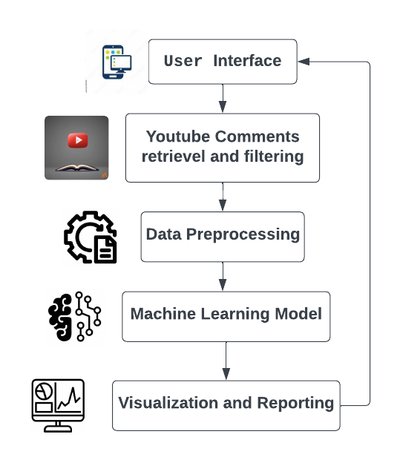
System Interaction Block Diagram

Slide 9
Status of the Work
 | Objectives | Status of Work
1. | To Conduct a literature review to gather insights on sentiment analysis, NLP techniques, and brand reputation analysis specific to YouTube comments. | Completed
2. | To Collect and preprocess data, including cleaning and preparation. Acquire labelled data through a pretrained NLP model and conduct additional data processing. | Completed
3. | To Train and fine-tune the model using appropriate machine learning or deep learning algorithms. | Completed
4. | To Evaluate model using metrics, optimize as needed. Test with real YouTube comments via appropriate UI. | Completed

Slide 10
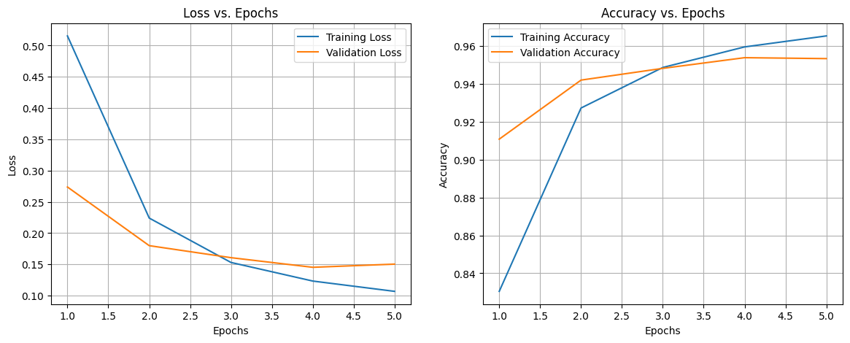
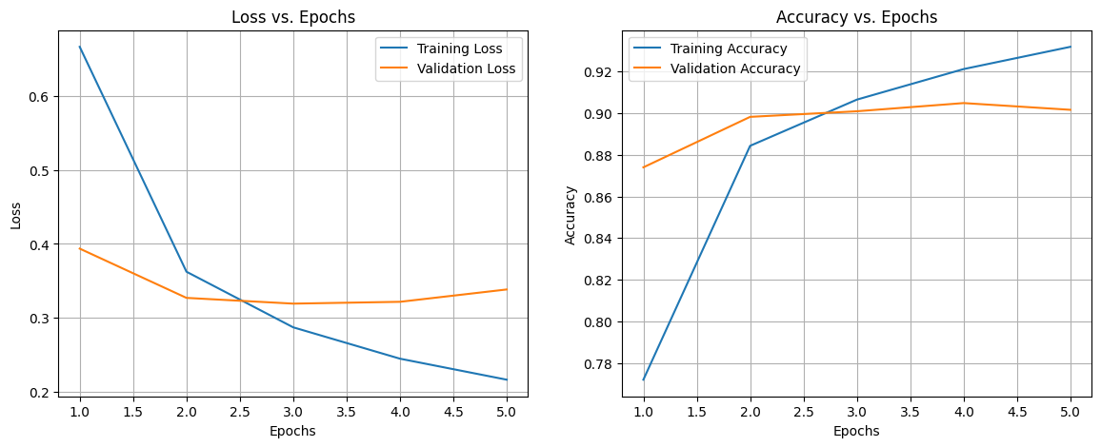
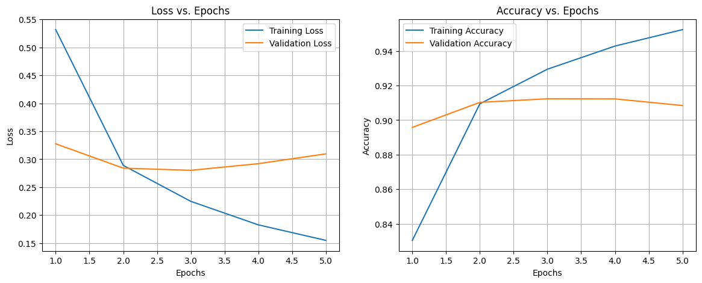
Results
Loss vs. epoch graphs
LSTM
MLPNN
CNN

Slide 11
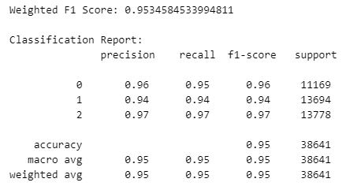
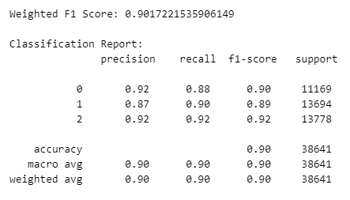
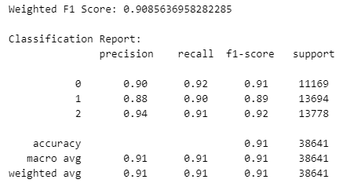
F1 Score, Precision and Recall
LSTM
MLPNN
CNN

Slide 12
Comparison between the different models
Model | Weighted F1 Score | Accuracy | Precision (Class 0, 1, 2) | Recall (Class 0, 1, 2) | F1-Score (Class 0, 1, 2)
LSTM | 0.9534 | 95% | 0.96, 0.94, 0.97 | 0.95, 0.94, 0.97 | 0.96, 0.94, 0.97
MLPNN | 0.9017 | 90% | 0.92, 0.87, 0.92 | 0.88, 0.90, 0.92 | 0.90, 0.89, 0.92
CNN | 0.9086 | 91% | 0.90, 0.88, 0.94 | 0.92, 0.90, 0.91 | 0.91, 0.89, 0.92

Slide 13
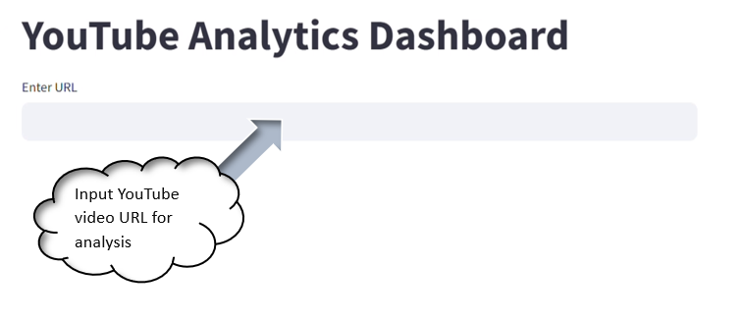
The 'Enter URL' field provides users with a dedicated space to input the YouTube video URL, allowing them to conveniently enter the specific video for analysis. Users can simply type in the URL of the video they wish to analyze.

Slide 14
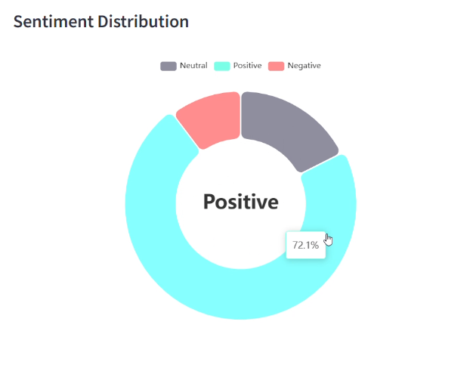
This pie chart visually represents the sentiment distribution of comments on the
Video:
Teal for positive
Red for negative
Grey for neutral.

Slide 15
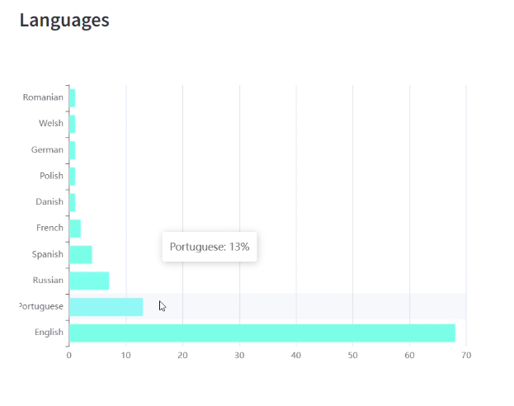
This bar chart showcases the distribution of languages in which comments are written on the video.

Slide 16
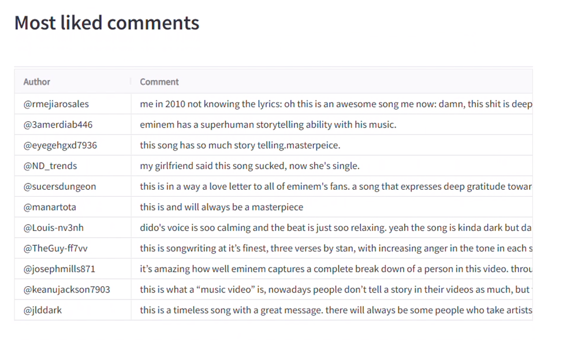
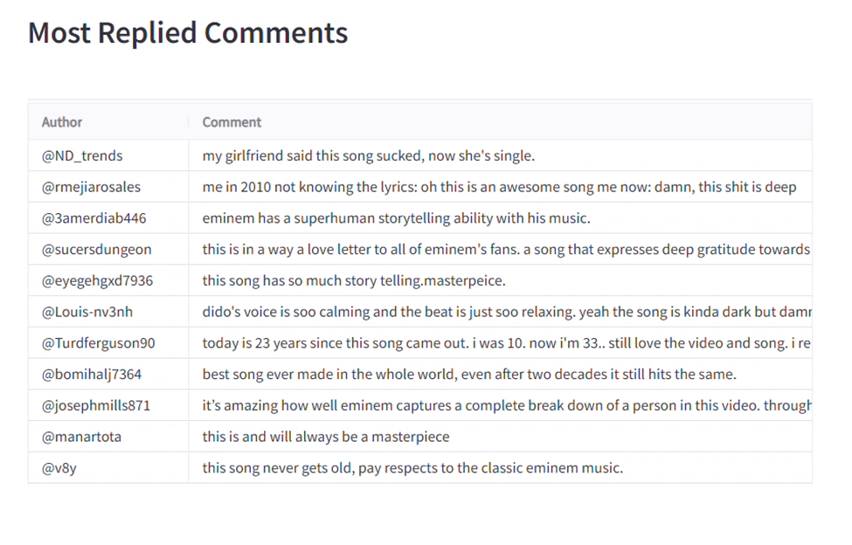
The "Most Liked Comments" section presents a ranked list based on the number of likes each comment has received.
The "Most Replied Comments" section displays comments ordered by the number of replies, highlighting the most engaging or discussion-provoking entries.

Slide 17
Expected Outcomes
Demonstration of working model.
Project Report

Slide 18
Cost Estimation
Serial Number | Resources and Work | Cost(Rs)
1 | Laptop (for development) | 70,000/-
2 | Human Resources (4 * 15,000/-) | 60,000/-
 | TOTAL | 1,30,000/-
Man hours:
Man hours per week (students): 18 *4 students =72
Man hours per week (faculty): 3

Slide 19
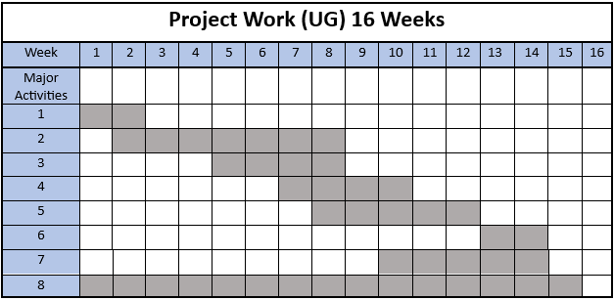
Gantt Chart
Literature review.
Obtain appropriate dataset and data-preprocessing.
Sentiment labelling using VADER.
Training the dataset with ML algorithm.
Model evaluation.
Real-time testing.
Design and development of UI.
Report Preparation.

Slide 20
References
Jyoti Gautam, Mihir Atrey, Nitima Malsa, Abhishek Balyan,Rabindra Nath Shaw, and Ankush Ghosh(2021)YouTube Sentiment Analysis and Topic Modeling on Healthcare Products: https://repository.ihu.edu.gr/xmlui/bitstream/handle/11544/30285/Anastasiou_Pan agiota_Dissertation_3308200001.pdf?sequence=1
Comparison of Neural Network Models for Sentiment Analysis: https://dergipark.org.tr/en/download/article-file/1506505
A sentiment analysis of the Ukraine-Russia conflict tweets using Recurrent Neural Networks https://www.researchgate.net/publication/361275253_A_sentiment_analysis_of_the_Ukraine-Russia_conflict_tweets_using_Recurrent_Neural_Networks
Twitter Data Sentiment Analysis Using Naive Bayes Classifier and Generation of Heat Map for Analyzing Intensity Geographically https://www.researchgate.net/publication/350932230_Twitter_Data_Sentiment_Analysis_Using_Naive_Bayes_Classifier_and_Generation_of_Heat_Map_for_Analyzing_Intensity_Geographically
Comparative Study of CNN and RNN for Natural Language Processing https://browse.arxiv.org/pdf/1702.01923.pdf
Hochreiter, S., and Schmidhuber, J. (1997). Long short-term memory.Neural computation, 9(8), 1735-1780 https://direct.mit.edu/neco/article-abstract/9/8/1735/6109/Long-Short-Term-Memory?redirectedFrom=fulltext

Slide 21
References
7. Benchmarking data-driven rainfall–runoff models in Great Britain: a comparison of long short-term memory (LSTM)-based models with four lumped conceptual models. https://hess.copernicus.org/articles/25/5517/2021/
8. AfriSenti: A Twitter Sentiment Analysis Benchmark for African Languages
https://arxiv.org/pdf/2302.08956v4.pdf
9. Sentimental analysis of amazon customers based on their review comments
https://typeset.io/papers/sentimental-analysis-of-amazon-customers-based-on-their-2jb1il2e
10. Sentimental Analysis of YouTube Videos by IJRET
IRJET-V7I12374.pdf

Slide 22
Thank You

